Slide 1

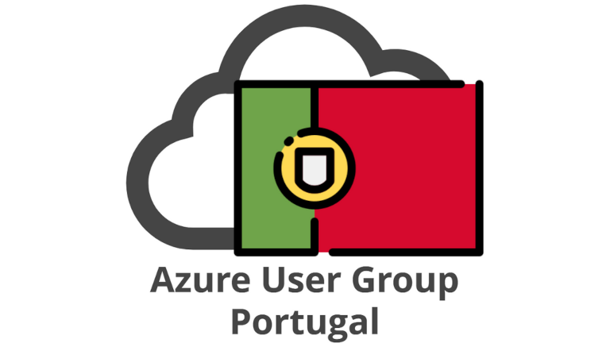

Welcome to
Global Azure Portugal
2024
Deep Dive into AKS
Marco António Silva – National Innovation Officer & Senior Cloud Solution Architect @ Microsoft
Renato Ribeiro – Cloud Solution Architect @ Microsoft

Slide 2
Title of session: AKS Deep Dice
As of: 2024/04/17
Goals/Narrative: | Walk through AKS Main Architectures Cover best practices
Announcements: | None
Session flow continued… | 5 minutes | Speaker
Act Three: Closing | <time> mins
Closing <GRAPHICS, DEMO> Cloud Native is the way to go Rest of day motivation | 3 min | Renato + Marco
Q&A (optional)
Audience Q&A (through chat; 5-10 minutes) | 0 mins | Team
Session flow: | 45 min | Speaker
Act One: Why AKS in Cloud Native | <time> mins
Introduction <GRAPHICS> Short intro to the session Demo Architecture Explained | 5 min | Renato
Act Two: Demos and mode Demos | <time> mins
Istio <GRAPHICS> Short Explanation + Demo | 3 min | Renato
App Routing <GRAPHICS> Short Explanation + Demo | 7 min | Marco
Observability <GRAPHICS> Short Explanation + Demo | 7 min | Renato
Workload Identity w/ OpenAI<GRAPHICS> Short Explanation + Demo | 10 min | Marco
Node Auto provisoning <GRAPHICS> Short Explanation + Demo | 5 min | Renato
Fleet Management <GRAPHICS> Short Explanation + Demo | 3 min | Marco

Slide 3

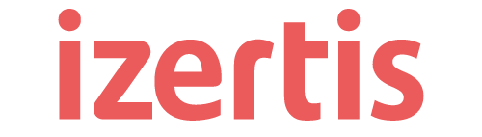



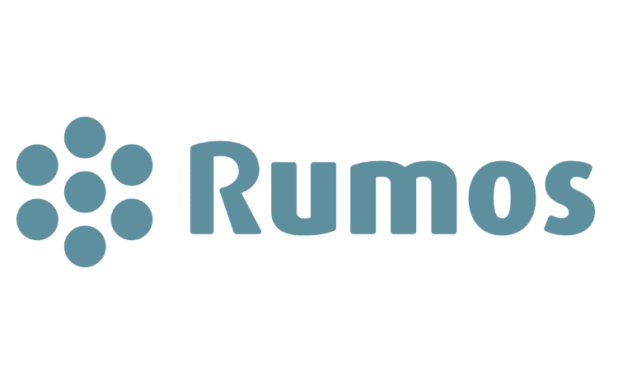



Location
Diamond
Gold
Silver
Swag

Slide 4
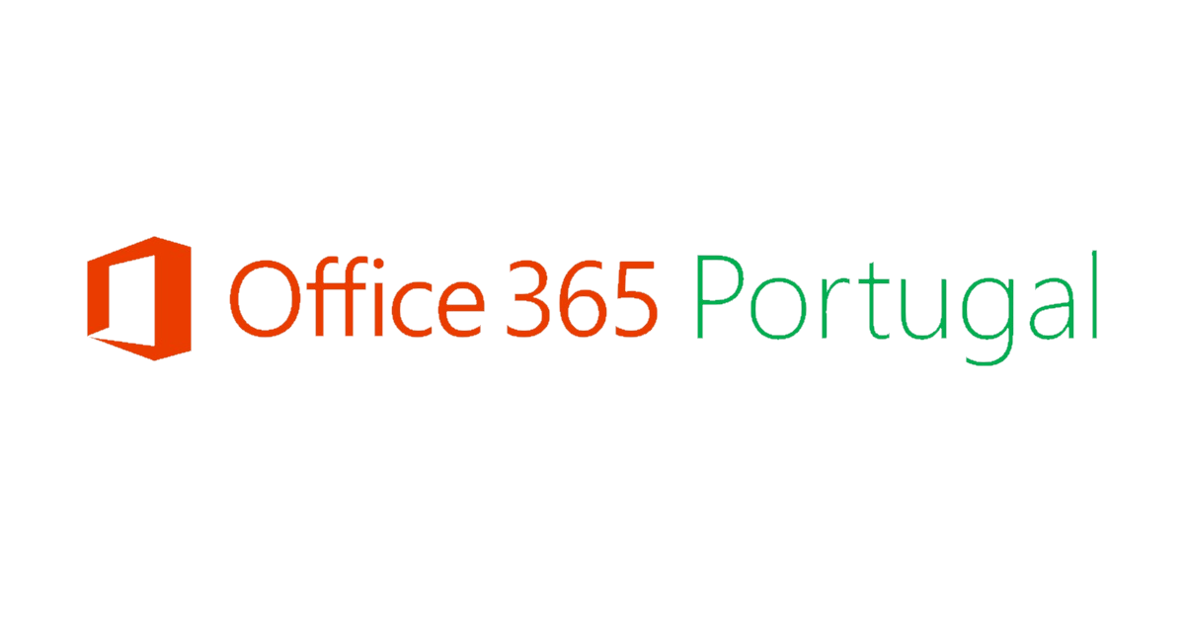





Community Sponsors

Slide 5
The world is always evolving
Changing economic conditions
Accelerating tech innovation
AI enables
new opportunities
Requiring a plan in place to be agile
Embracing cloud native to stay ahead
Empowering growth & innovation
Notes:
SPEAKER Script:
In today’s world, things all around us are rapidly changing, and organizations need to adapt. This is nothing new.
Looking back over the past few years, we’ve seen organizations that invested in building a strong digital foundation were able to weather disruption better than their peers and many emerged even stronger than before. ​
We believe we're on the cusp of a similar inflection point. ​Although today’s pressures are different, industries are continuing to evolve and adjust at a rapid pace.​
Managing through changing economic conditions requires flexibility and agility. As we face complexities such as security threats, inflation, developer shortages, government regulations and other global issues, having a plan in place and building a secure, resilient environment are paramount.
​With those shifting conditions, tech innovation has soared, and so have rewards for organizations that embrace this change. An overwhelming 75% of leaders are building all future new products and features in the cloud to stay ahead in this dynamic landscape.​
AI is no longer a distant concept; it's an integral force in our daily lives, revolutionizing industries and creating new opportunities.
As we move forward, we must embrace challenge and seize the opportunity that AI and digital transformation present. Together, we can shape a future that is secure, customer-centric, and compliant - while harnessing the true potential of AI to drive innovation and progress.
Seller Actions:
Listen & understand customer challenges, needs. Ask customer: What are your biggest concerns that we can help you navigate?
Source:
An overwhelming 75% of leaders are building all future new products and features in the cloud to stay ahead in this dynamic landscape.​ State of Cloud | Pluralsight: https://www.pluralsight.com/resource-center/state-of-cloud

Slide 6

By 2027, more than 90% of global organizations will be running containerized applications in production - Gartner’s “The CTO’s Guide to Containers and Kubernetes”
Notes:
Organizations of any size can be using containers – big or small, cloud native vs looking to modernization legacy apps. In fact by 2027, Gartner has project that more than 90% of global organizations will be running containerized applications in production. In the years to come we will continue to see huge amount of growth in adoption for containers, Kubernetes, and manged services like AKS.

Slide 7



AKS provides a modern platform for your apps
Choice
Integrated with IDEs for
your favorite framework/language, bring your code or container
Integrated CI/CD
Delivery w/ GitHub AS, GitHub Actions, Azure DevOps, and others
Blue-green deploys
Seamlessly rollout new versions of apps for user testing or change management while maintaining uptime
Reliability and scale
Autoscale, high availability with a service-level agreement (SLA)-backed uptime, continuous backups
Patching/upgrade
Automatic platform maintenance and security patching. Rolling updates w/o downtime, version pinning, rollbacks
Observability
System insights for faster issue resolution, health checks
Security
Policy enforcement, RBAC, secrets management, authN and authZ, secure container supply chain
Self healing and resilience
Health checks and self healing of unhealthy apps, harden using chaos engineering principles, and load testing tools
Managed operations
Opinionated and simplified operations through a fully managed service. Managed addons, nodes & lifecycle
Notes:
That’s so much goodness for all our Ops folks out there.
But lets not forget the devs - These platforms enable developers to leverage the benefits of containerization, for microservices architectures as well as stateful workloads, and use your favorite CI/CD tools to go straight from your code in Github through a secure software supply chain to land on AKS leveraging the easy blue-green deploy capability in kubernetes without sacrificing uptime for your app.

Slide 8
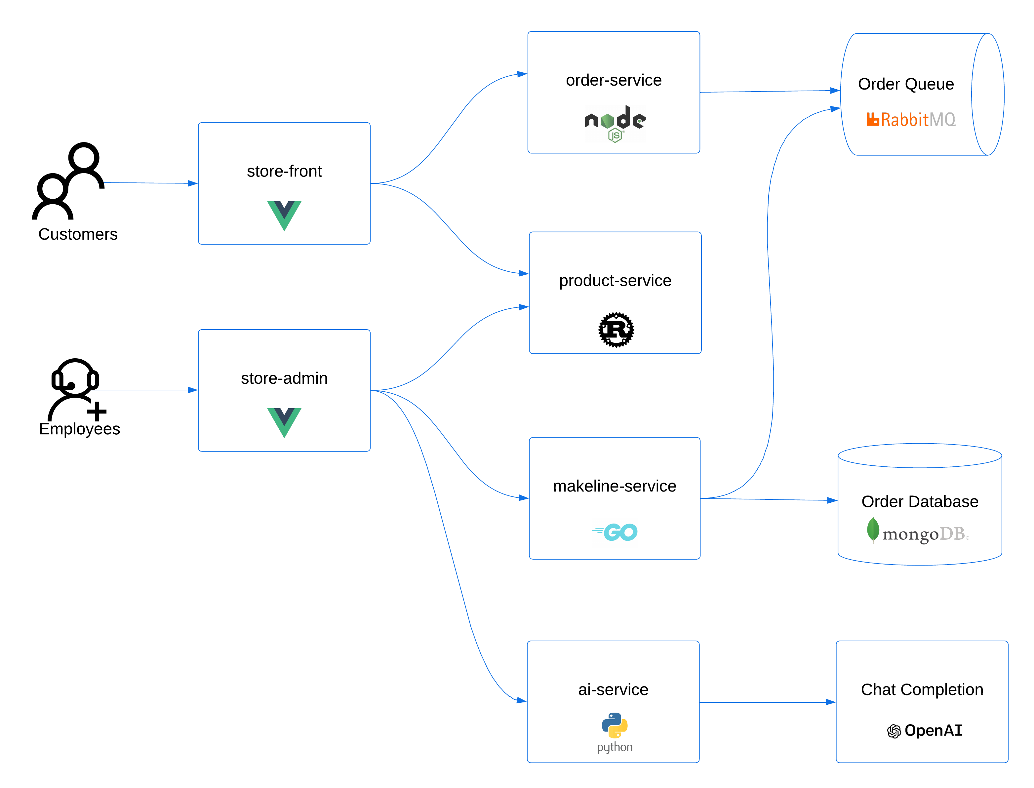
AKS Store Demo App - Architecture
Demo app for showcasing AKS features
Retail scenario – Pet supply store
Microservices architecture
Multi programming languages
Multi frontend exposure

Slide 9
Istio

Slide 10


Istio service mesh add-on
GA
Challenges we heard from users
AKS Istio add-on
1
Coordinating upgrades for Istio and underlying Kubernetes versions is a pain
1
Istio versions tested and verified to be compatible with supported versions of AKS
2
Configuring and fine tuning Istio components to work with large scale clusters
2
Microsoft handles scaling and configuration of Istio control plane
3
Using Istio with self-managed Prometheus and Grafana
3
Microsoft adjusts scaling of AKS components like `coredns` when Istio is enabled
When there are any issues with Istio components or compatibility issues with underlying cluster, little to no support!
4
Verified external and internal ingress set-up
4
Verified to work with Azure Monitor-managed Prometheus and Grafana
5
6
Official Azure support provided for the add-on

Slide 11
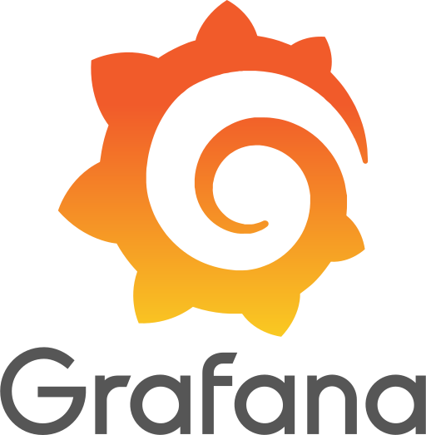



Istio service mesh add-on
Microsoft handles scale, compatibility with AKS, and configuration of AKS components like CoreDNS
Customer managed and part of workloads
Azure Managed Grafana
Service mesh control plane (istiod)
Data plane
Metrics
Azure Managed Prometheus
External ingress
Instance A
Instance B
Instance C
Internal ingress
Sidecar proxy
Sidecar proxy
Sidecar proxy
Tracing integration (coming soon)
Application Insights

Slide 12
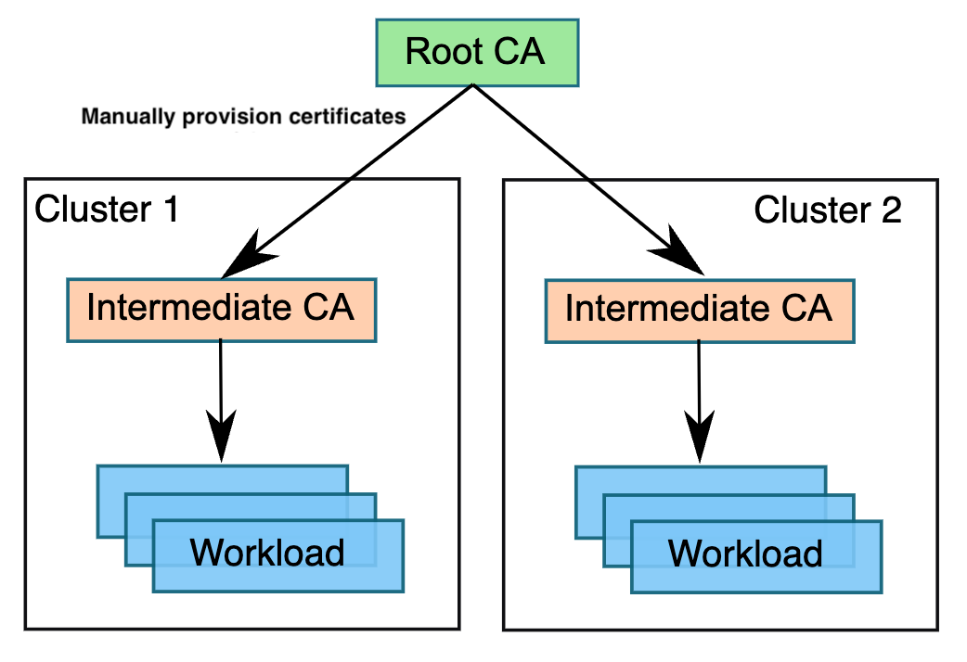

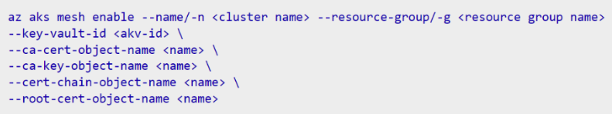
Istio based Service Mesh
GA: Plugin CA
Enables cross clusters mTLS authN
Backed by Azure Key Vault
Root CA and Intermediate CA rotation auto pickup

Slide 13
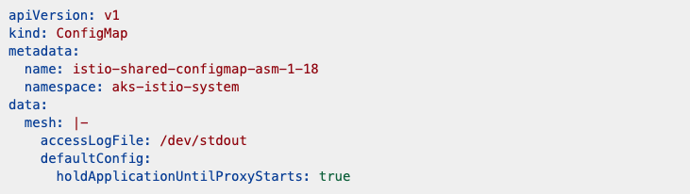
Istio based Service Mesh
GA: Mesh Config & Proxy Config
Builds on top of MeshConfig/ProxyConfig and classifies different properties as
Supported
Allowed
Blocked
Per-revision config

Slide 14
DEMO
Enabling Istio sidecar in namespace
Expose frontend service via Istio Ingress Gateway

Slide 15
App Routing

Slide 16

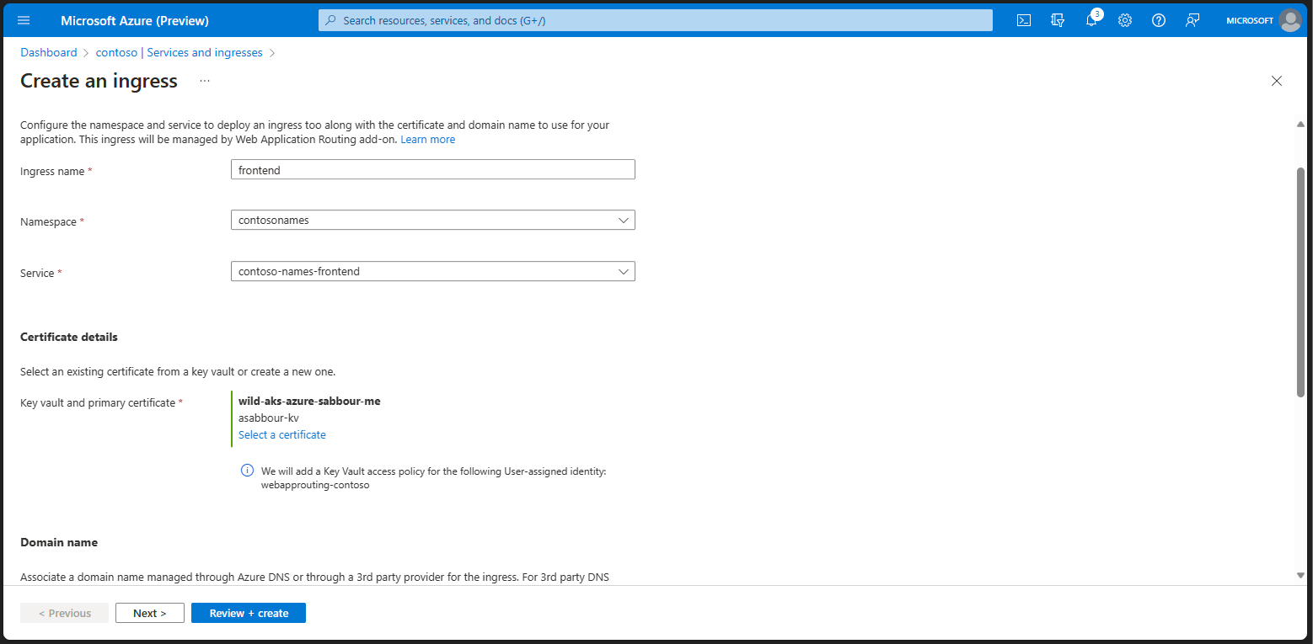
Application Routing add-on
GA
Application Routing add-on provides a managed in-cluster ingress controller that integrates with Azure Key Vault and Azure DNS
Managed ingress
Based on nginx, delivered as a managed add-on for AKS.
Secure by default
Integrated with Azure Key Vault to pull SSL/TLS certificates.
Automatic DNS management
Configure Azure DNS zones or use with 3rd party DNS providers.

Slide 17
DEMO
Expose frontend service via app-routing addon
Custom domain and SSL certificate configuration

Slide 18
Observability & Monitoring

Slide 19



Challenges with Monitoring Kubernetes
Technical
Operational
Organizational
Scalability
Large surface area
High Resource demand
Configuration Management
Alert Fatigue
Integration complexity
Data Management
Compliance and Governance
Collaboration and Skilling
Cost Management and Attribution

Slide 20



Structured Monitoring Paradigm
Detect
Diagnose
Remediate

Slide 21
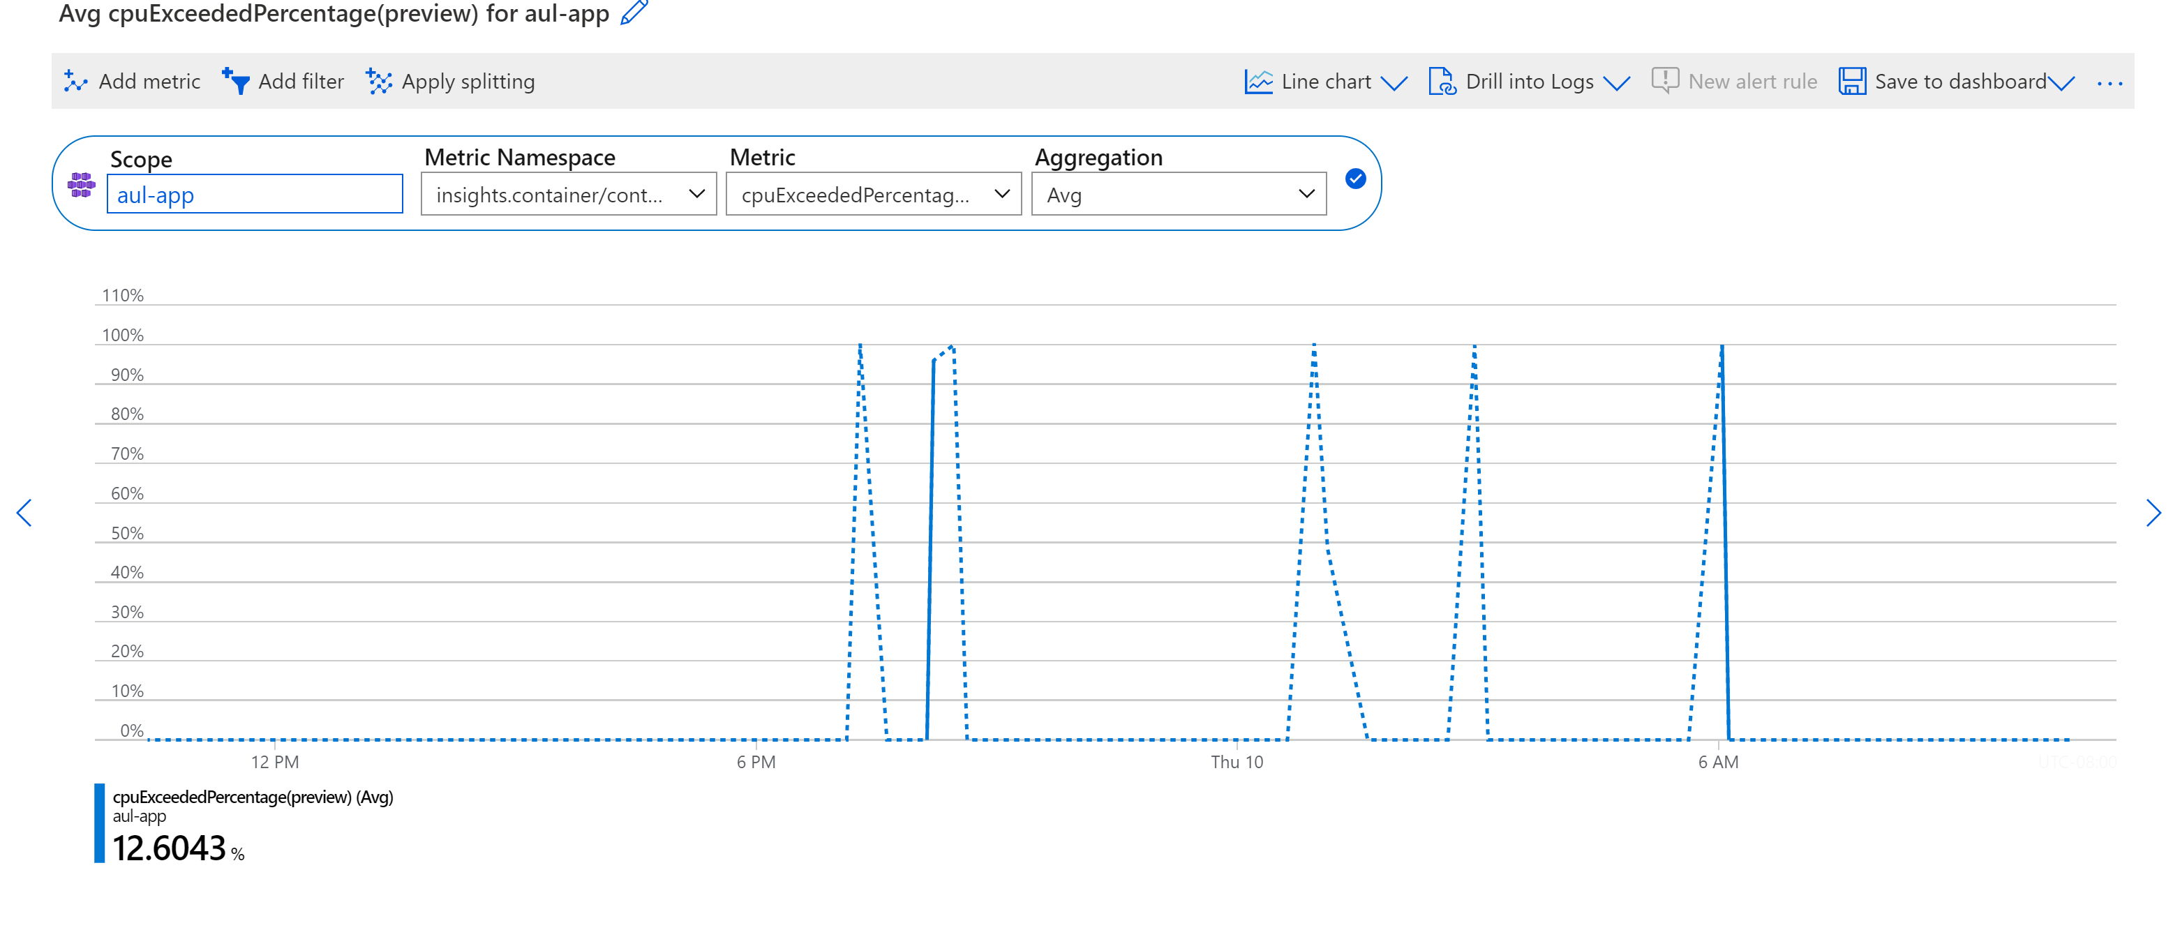
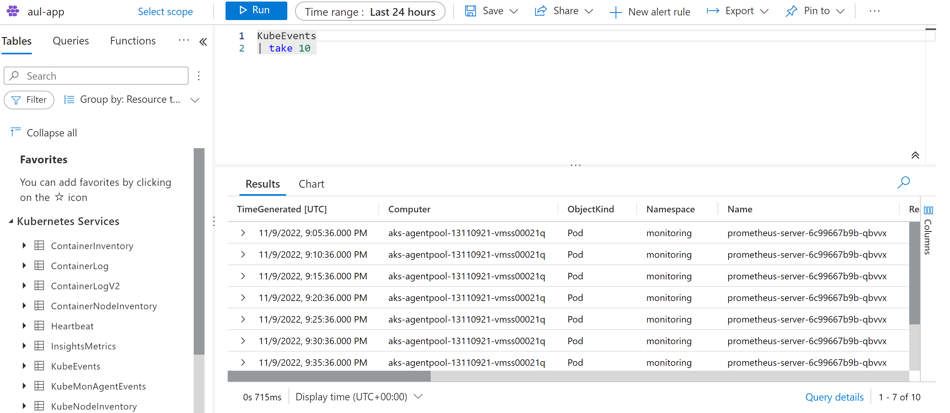
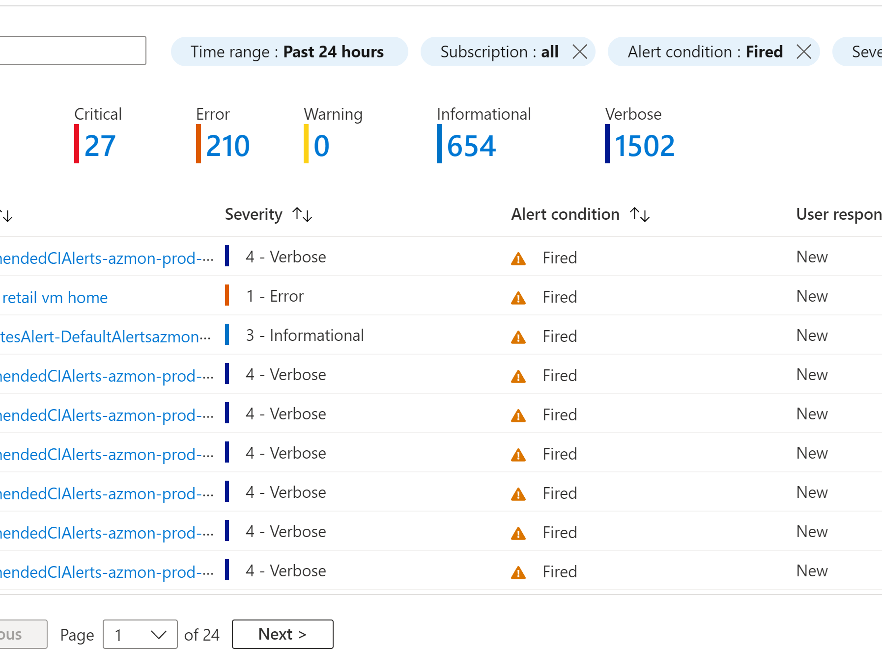
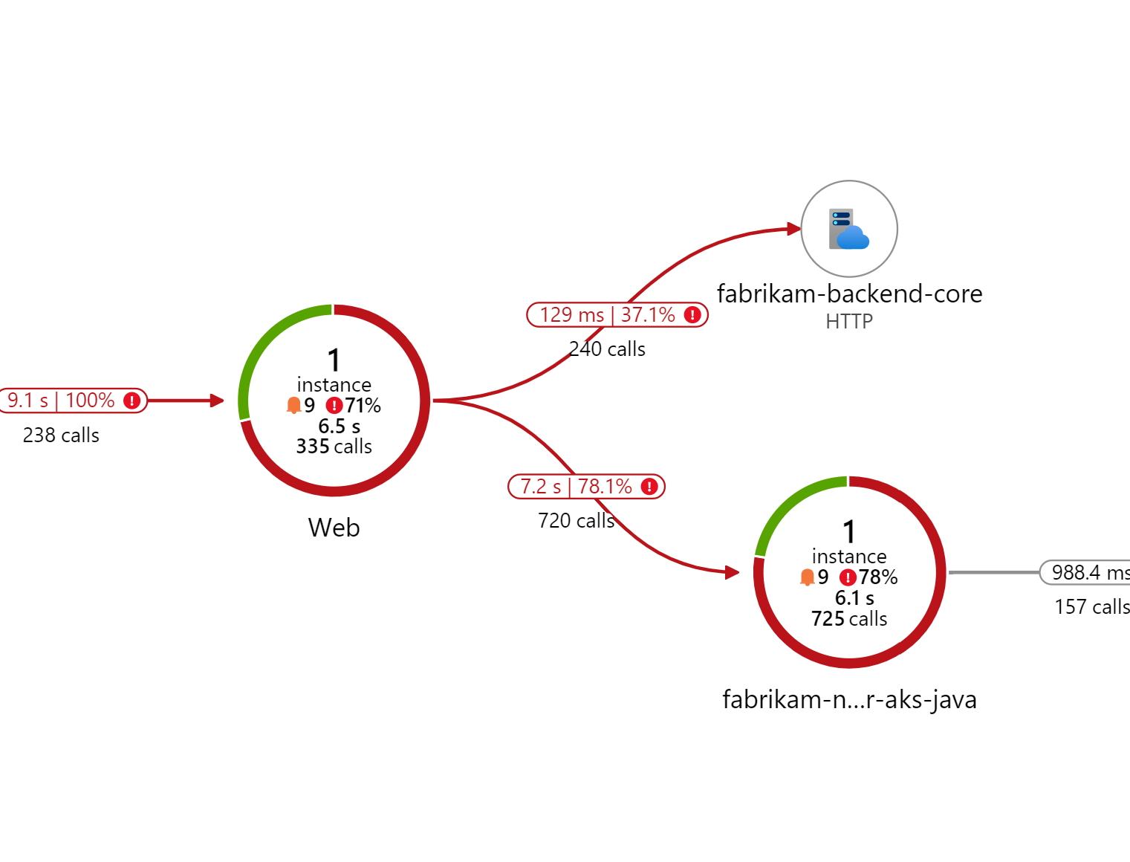
The Four Pillars of Observability
Metrics
Logs
Alerts
Traces
Prometheus
Container Insights
Azure Alerts (Logs)
Prometheus Alerts (metrics)
App Insights
Notes:
Azure Monitor now offers a unified cloud native offering for Kubernetes monitoring
Logs - Azure Monitor Container insights
Metrics - Azure Monitor managed service for Prometheus (Preview)
Visualization - Azure Managed Grafana
Gain continuous visibility into services and infrastructure
Get the power of open-source monitoring tools with minimal toil

Slide 22
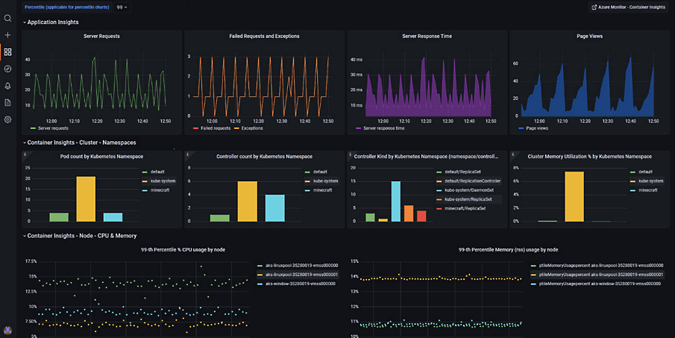

16x9 Dark: Announcement
Generally Available
Azure Monitor managed service for Prometheus
Azure Managed Grafana
A fully managed service for analytics and monitoring solutions built on top Grafana
Collect and analyze metrics at scale with HA ingestion and query endpoints
Integration with AKS and Azure Arc-connected Kubernetes clusters
18 months of data retention at no extra cost
Works with Azure Managed or Custom Grafana
Simple integration with managed Prometheus
Use prebuilt dashboards or import custom charts directly from the Azure Portal
Control which users can use a Grafana instance using Azure Active directory identities
Notes:
BRENDAN:
The results of the contribution from Microsoft is the managed services such as Managed Prometheus
That can be applied to any of your AKS clusters including Arc-enabled K8s clusters
With 18months of data retention at no extra cost

Slide 23

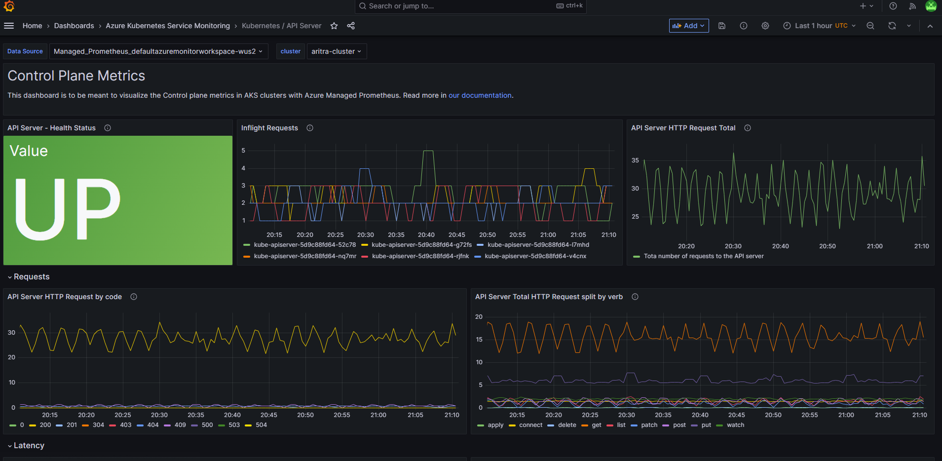
Control Plane Metrics in Managed Prometheus
Public Preview
Monitor critical metrics from API server, ETCD, Auto-scaler, Controller manager, Scheduler
Customize metrics through scrape config
Out-of-the-box dashboards in Managed Grafana

Slide 24

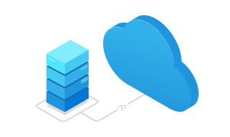


E2E Network Observability offering for AKS
Observe
Ingest
Storage
Visualize
Network Observability add-on
(Retina)
Azure Monitor
Azure-managed Prometheus
Azure-managed Grafana

Slide 25
How does it work?
eBPF observability dataplane
Cloud, OS, CNI Agnostic
Microsoft Retina
Notes:
Retina is built as cni independent.(it has agent, extension plugins and exports) and can work with any cni. Cilium cni is tightly monlith package which includes observability, security in it. We don't need to run retina when running with cilium. Over time we need to work with cilium community to break into disagreegated pieces so it can interop with others such as retina

Slide 26
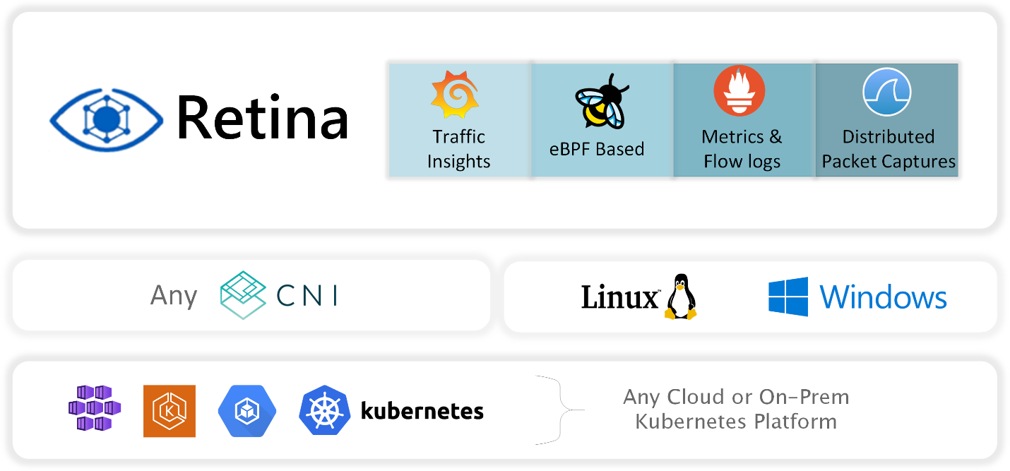
Open Sourcing Microsoft Retina
Cloud native platform for Networking Observability
Extensible and adaptable, works with all CNIs, OS, and cloud providers
L4/L7 metrics and powerful distributed packet capturing capability
To learn more checkout: aka.ms/retina
https://github.com/microsoft/retina

Slide 27
DEMO
Integrate with managed Prometheus
Dashboards via managed Grafana

Slide 28
Workload Identity

Slide 29
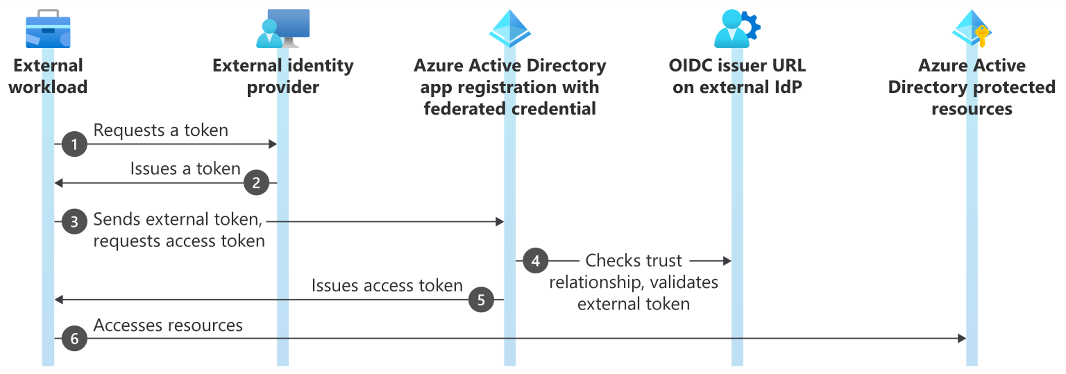
Workload Identity Federation
Allows you to access Azure Active Directory (Azure AD) protected resources without needing to manage secrets

Slide 30
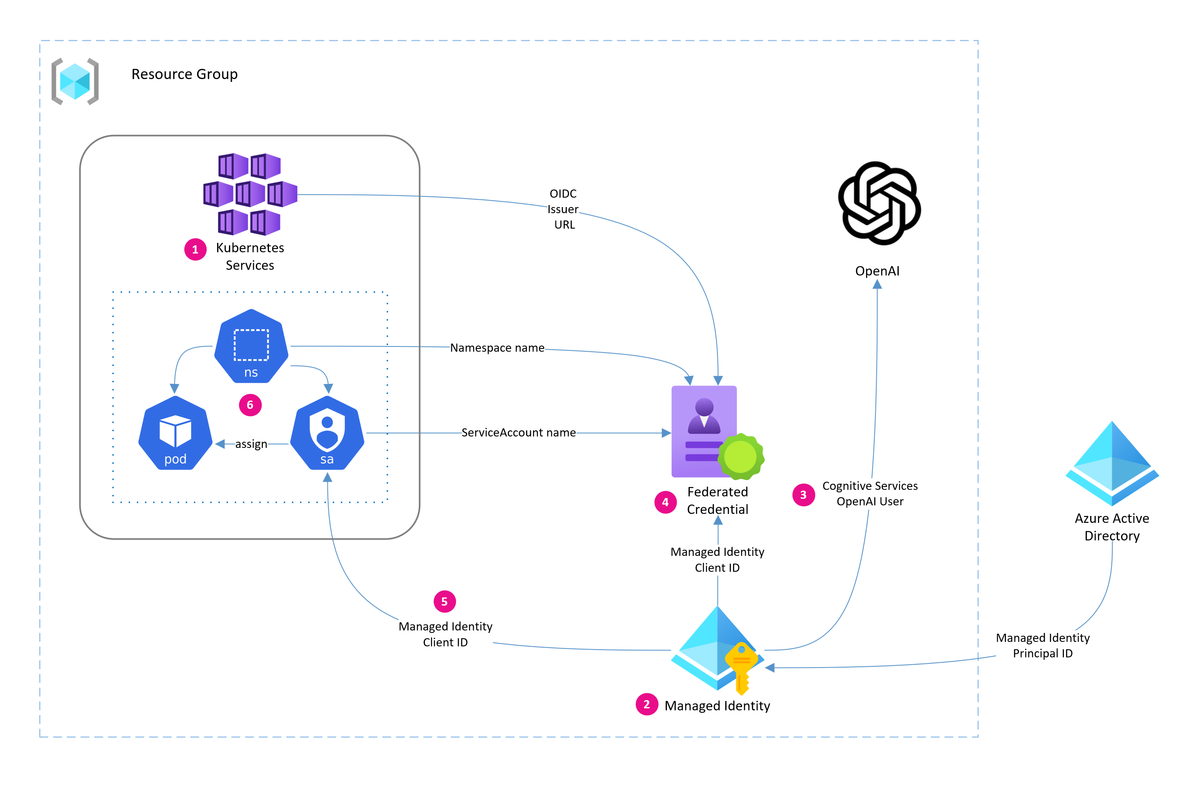
Workload Identity Configuration Overview
Enable workload identity and OIDC endpoint
Create managed identity
Assign RBAC for Azure OpenAI
Create federated credential
Create ServiceAccount
Assign ServiceAccount to Pod

Slide 31
DEMO
Integrate workload identity with openAI service

Slide 32
Node Auto-provisioning

Slide 33
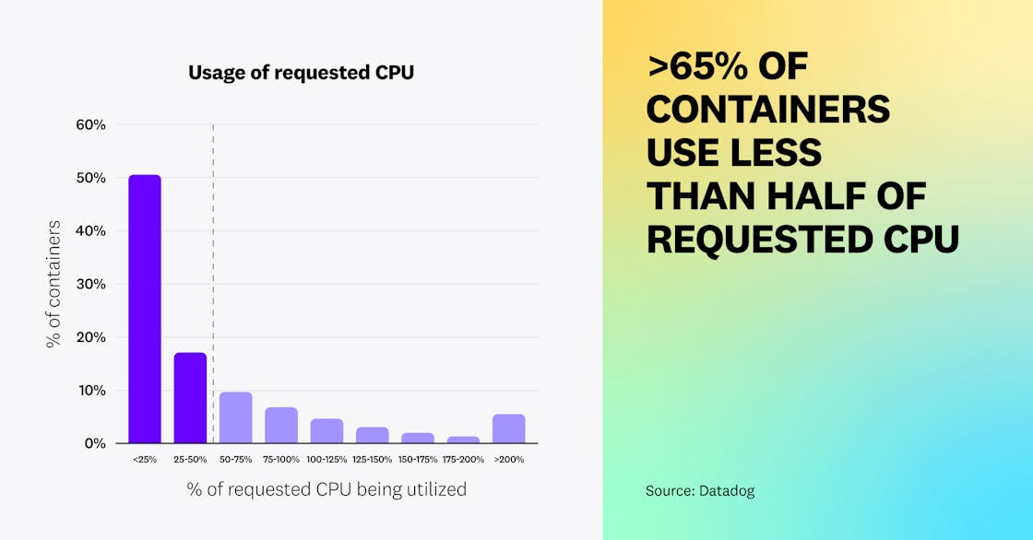
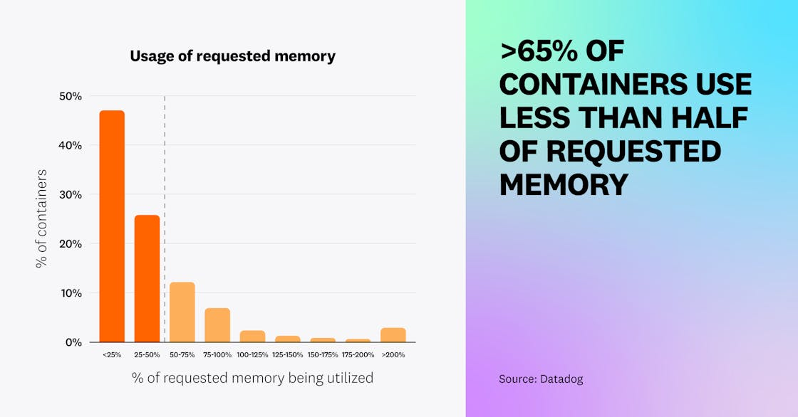
Overprovisioning is the #1 factor leading to overspend
Datadog: 10 insights on real-world container use
Notes:
In the cloud world, we see a lot of customer overprovisioning and underutilizing infrastructure which can lead to costs spiraling out of control. You should be able to binpack your applications efficiently enough to hit 80-90% utilization of your infrastructure but In reality we do not see this.
A data dog container report , called out that 65% or workloads are being underutilized from a Cpu and memory perspective. There is a lot of opportunity to do better here.

Slide 34
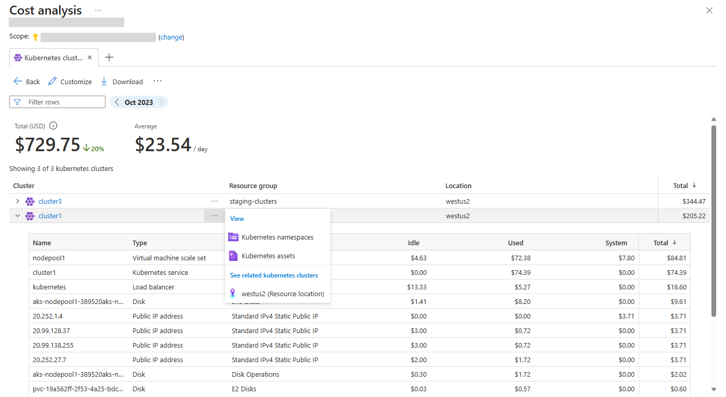
AKS Cost Analysis
General Availability
Azure native cost allocation and visibility experience
https://aka.ms/aks/docs/cost-analysis
Granular cluster infra cost breakdown by k8s constructs
Data reported directly in Azure Portal UI
Standard and Premium tier AKS clusters
1st native cloud provider cost visibility experience built on top of OpenCost
1st service specific cost drilldown in Azure Cost Management
Notes:
Great news for you we have a solution for folks who don’t have any cost monitoring in place or are looking to use a native solution vs 3P tooling. AKS cost analysis addon is a native cost allocation and visibility experience. Now in GA.
Provides visibility into cluster infrastructure costs by Kubernetes constructs such as namespace and cluster as well as azure resources category like compute, network, and storage. Data is reported directly in the Azure portal UI and it’s available for standard and premium aks clusters at no additional cost.
This addon is also bulit on top of opencost – a vendor neutral, open source cncf sandbox project. That we are partnered closely with and contributing to.

Slide 35
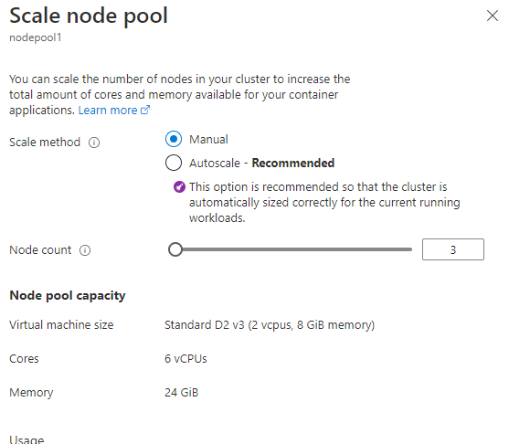
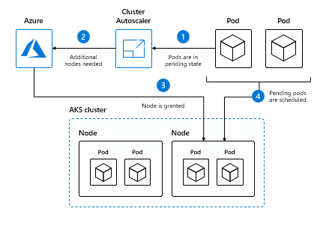
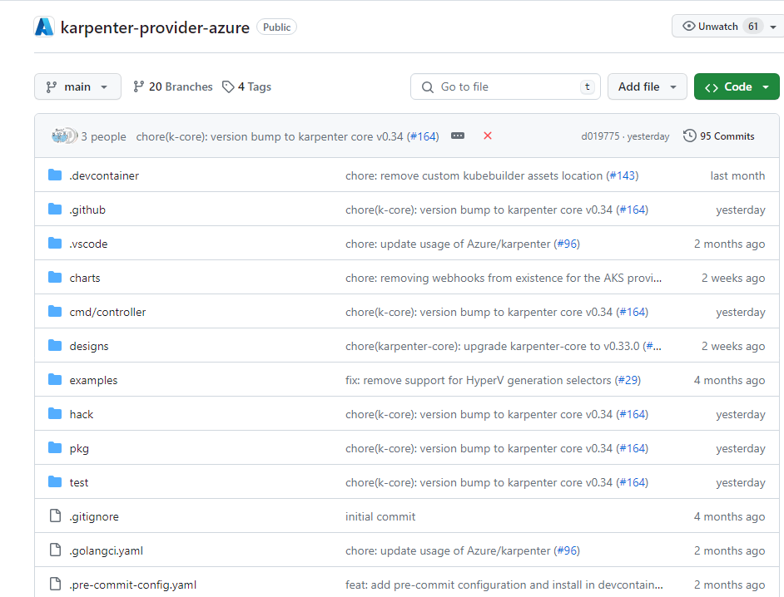
Node scaling
Manual Scaling
Cluster Autoscaler
Node Auto Provisioning
Manually scale up the AKS cluster Nodepool for anticipated application load or deployments
Set --scale-down-mode Deallocate to reduce cost and speed up scale up times​.Deallocate nodes rather than deleting them​
Responds to unscheduled “pending” pod load and automatically scales up the nodes in response
Often used with HPA
Efficient Resource Utilization: NAP determines the optimal VM configuration based on pending pod resource requirements.
Automated Decision-Making: NAP selects the most suitable VMs to run your workloads, reducing the manual effort required for VM configuration design and operational cost
Notes:
Manual scaling – decide both VM sku and no.
Cluster Auto scaler – decides no. of nodes.
NAP – decides intelligently the best cost effective SKU and the number is optimized.
NAP
Efficient Resource Utilization: NAP automatically determines the optimal VM configuration based on pending pod resource requirements. This ensures efficient resource allocation and cost-effectiveness.
Automated Decision-Making: NAP selects the most suitable VMs to run your workloads, reducing the manual effort required for VM configuration design and operational cost.

Slide 36


Node auto provision
Public Preview
Deploy the right infrastructure for your workloads and efficiently bin pack your applications to reduce running costs.
Built on the Open Source Karpenter project, with the AKS provider also being made openly available.
Notes:
Copilot announcement, CLI, Kaito and app routing GA

Slide 37
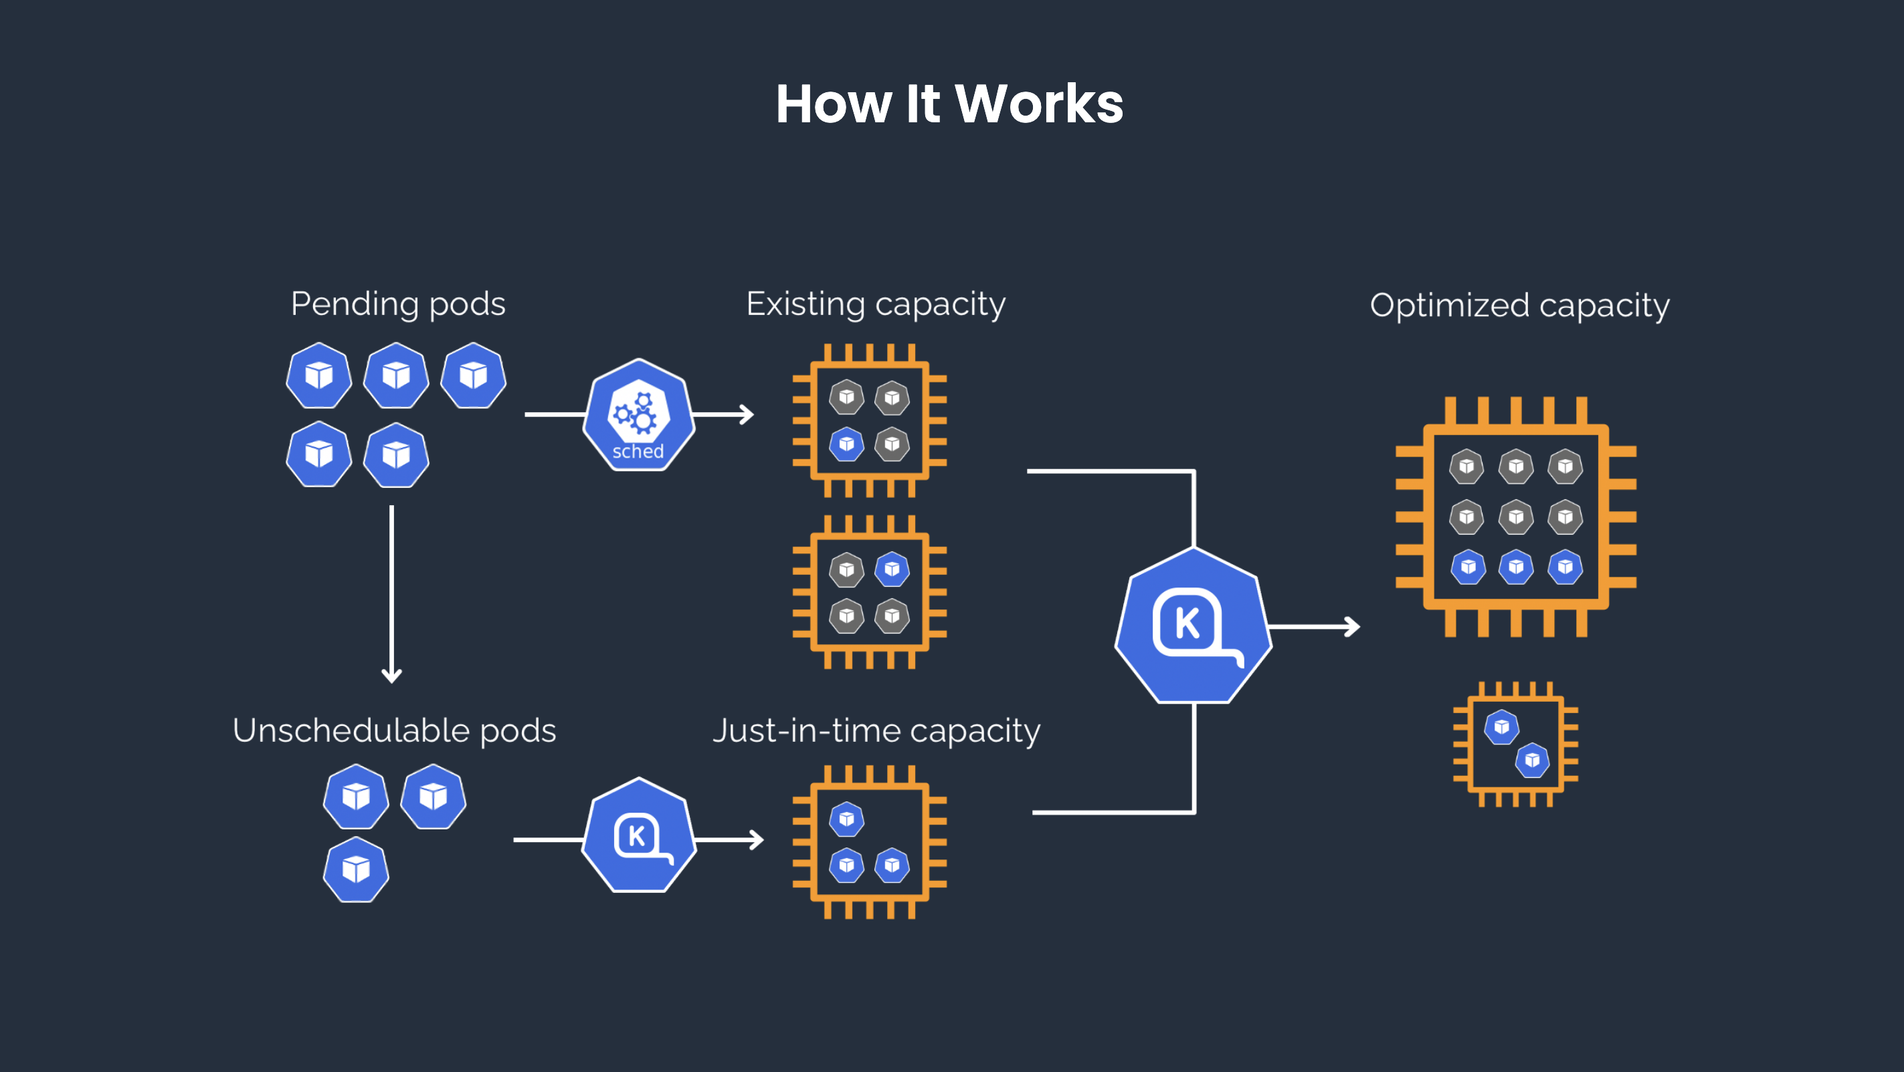
Karpenter

Slide 38
Consider All SKUs on Azure Available in that region
All Azure SKUs
792 SKUs
AKS Requirements
2. Filter out SKUs that are undesirable for K8s Nodes
484 SKUs
201 SKUs
3. Filter for AMD64 SKUs, and SKUs from the D Family
Nodepool Requirements
4. Workloads Require 16 vCPU, + node overhead. All skus need to meet the workloads requirements
Workload Requirements
58 SKUs
5. Pick Cheapest SKU from that list of 58 SKUs with quota

Slide 39
Consolidation
Multi-Node consolidation can combine Many Underutilized Nodes onto one node for higher utilization + better price
Single Node consolidation will evaluate can we replace the current node with a cheaper node that can schedule all of its pods
Empty Node consolidation will see if the node is empty and unneeded by pending pods
Node Replacement
Node Deletion

Slide 40
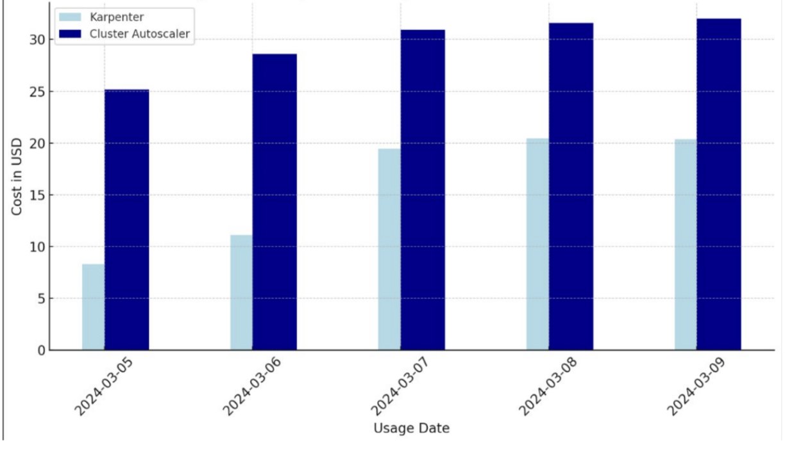
Daily Cost Savings: Karpenter vs CAS
46.22% Percent Savings

Slide 41
DEMO
Use a cluster with node auto provision enabled
Stress and scaling

Slide 42
Fleet Manager (Fleet)

Slide 43

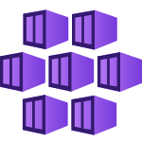
What is a Fleet?
Fleet (Lightweight grouping of resources)
Join as member clusters
subscription-a
subscription-b
member-a
member-b
member-c
Notes:
Now when you have hundreds of AKS clusters, across different subscriptions, RG, regions, it becomes extremely difficult to manage these clusters at scale.
A Fleet is simply a collection or group of AKS clusters. They can be in different subs, RG, regions (which is important for failover), as long as they are in the same tenant they can be joined to a fleet group.
particularly valuable for platform or infra teams that are responsible for scaling, upgrating, creating clusters etc.
Fleet today supports several key scenarios like
- Rolling upgrades, resource propagation, etc.

Slide 44
DEMO
Fleet manager portal
Operate at scale

Slide 45
OSS Fleet Workload Placement
https://aka.ms/fleet/workloadplacement
Schedule based on cost metrics
Per-resource-unit cost
cost-per-cpu core
cost-per-gb memory
Scenario: scheduling CPU intensive workloads to cluster with cheapest CPU resources
Allocatable/available resources
Allocatable/available cpus
Allocatable/available memory
Scenario: scheduling to cluster with most available memory to run my app
Number of nodes
Scenario: balance resources usage across clusters, eliminate hot spots
Notes:
A new capability that we want to share is workload placement based on cost metrics
We’re extening Fleet’s existing resource propagation capabilities with a set of new cost heuristics. Cost based wp has been buit completely in the open as OSS,
What is the value add? Well having balanced clusters eliminates potential hotspons in a multicluster env, where specific clusters aren’t getting overloaded
Balance resource usage across clusters
Make full use of the clusters resources.

Slide 46
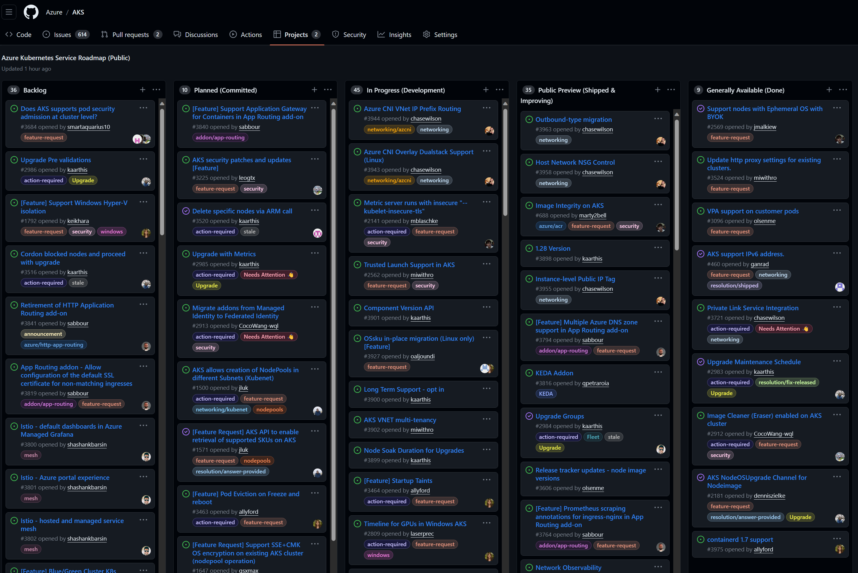
AKS Public Roadmap (GitHub)
https://aka.ms/aks/roadmap

Slide 47
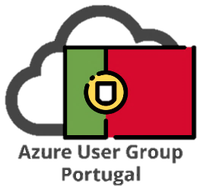
Thank You
Marco António Silva
National Innovation Officer &
Senior Cloud Solution Architect @ Microsoft
Digital & App Innovation
Renato Ribeiro
Cloud Solution Architect @ Microsoft
Digital & App Innovation
https://github.com/RenatoSGR/aks-globalazure

Slide 48
Location
Diamond
Gold
Silver
Swag

Slide 49
Community Sponsors

